Slide 1
Composition API

Slide 2
What You Will Learn
Problems w/ the Options API
Replacing Options API

Slide 3
Problems w/ Options API

Slide 4
Options API
Problems w/ Options API
In Options API, we create a configuration object and in there configured various options
data, methods, computed, watch, lifecycle methods
Notes:
We setup such options so we can run events, etc. this approach is absolutely fine and you can stick to it. There are 2 main limitations to the Options API

Slide 5
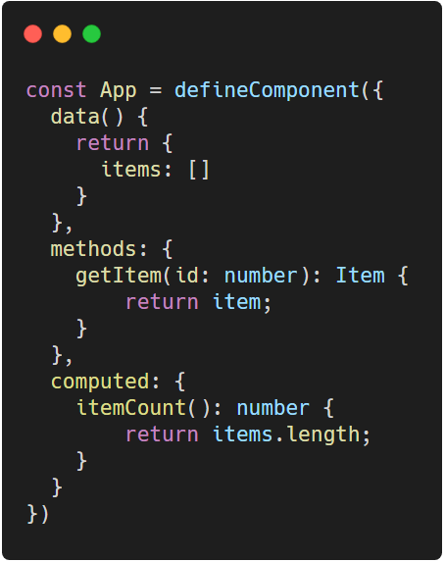
Limitations of Options API
Problems w/ Options API
Code that belongs logically is split up across multiple options
Notes:
In a small to medium sized application, this isn’t a real problem. But imagine if your code base is very long.
Though a long code base usually imposes a code smell, it could still happen. And there are also people who aren’t fans of separating by options
Code: https://carbon.now.sh/?bg=rgba%28255%2C255%2C255%2C1%29&t=vscode&wt=none&l=javascript&ds=false&dsyoff=20px&dsblur=68px&wc=true&wa=true&pv=56px&ph=56px&ln=false&fl=1&fm=Hack&fs=14px&lh=133%25&si=false&es=2x&wm=false&code=const%2520App%2520%253D%2520defineComponent%28%257B%250A%2520%2520data%28%29%2520%257B%250A%2520%2520%2520%2520return%2520%257B%250A%2520%2520%2520%2520%2520%2520items%253A%2520%255B%255D%250A%2520%2520%2520%2520%257D%250A%2520%2520%257D%252C%250A%2520%2520methods%253A%2520%257B%250A%2520%2520%2520%2520getItem%28id%253A%2520number%29%253A%2520Item%2520%257B%250A%2520%2520%2520%2520%2509return%2520item%253B%250A%2520%2520%2509%257D%250A%2520%2520%257D%252C%250A%2520%2520computed%253A%2520%257B%250A%2520%2520%2509itemCount%28%29%253A%2520number%2520%257B%250A%2520%2520%2509%2509return%2520items.length%253B%250A%2509%257D%250A%2520%2520%257D%250A%257D%29

Slide 6
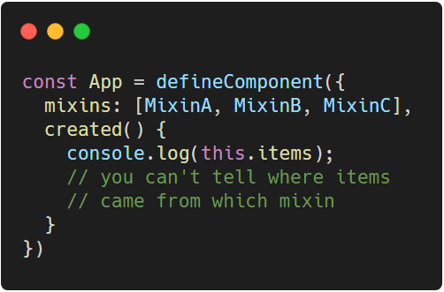
Limitations of Options API
Problems w/ Options API
Re-using/maintaining logic across components can be tricky
Notes:
You definitely can reuse logic, just by doing code sharing. The problem lies in finding which specific code you are going to modify. This will be tackled more when hooks is discussed.
Code: https://carbon.now.sh/?bg=rgba%28255%2C255%2C255%2C1%29&t=vscode&wt=none&l=javascript&ds=false&dsyoff=20px&dsblur=68px&wc=true&wa=true&pv=56px&ph=56px&ln=false&fl=1&fm=Hack&fs=14px&lh=133%25&si=false&es=2x&wm=false&code=const%2520App%2520%253D%2520defineComponent%28%257B%250A%2520%2520mixins%253A%2520%255BMixinA%252C%2520MixinB%252C%2520MixinC%255D%252C%250A%2520%2520created%28%29%2520%257B%250A%2520%2520%2520%2520console.log%28this.items%29%253B%250A%2520%2520%2520%2520%252F%252F%2520you%2520can%27t%2520tell%2520where%2520items%250A%2520%2520%2520%2520%252F%252F%2520came%2520from%2520which%2520mixin%250A%2520%2520%257D%250A%257D%29

Slide 7
Composition API
Problems w/ Options API
An alternative way of writing the logic behind the components and was introduced to face the limitations of Options API
Notes:
Emphasis on alternative as using Options API is entirely valid. In composition API, we bundle our logic in a different way.

Slide 8
Composition API - analogy
If you have the following:
Banana, Orange, Bell Pepper, Cabbage, Broccolli, Apple, Pineapple, Squash
How would you group them according to:
Fruits or vegetables
Seedless or not
Notes:
Out of this example, I need you to group them accordingly. How would you approach it?

Slide 9
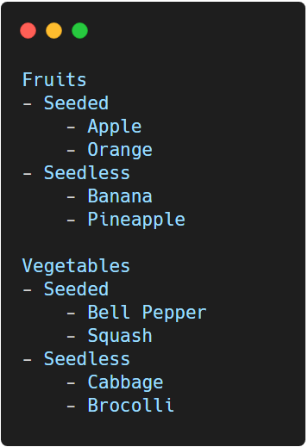
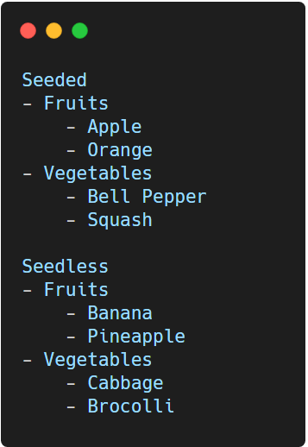
Composition API - analogy
Problems w/ Options API
Notes:
In this analogy, you have totally different approaches that leads to the same goal which is to group them accordingly.
Analogy 1: https://carbon.now.sh/?bg=rgba%28255%2C255%2C255%2C1%29&t=vscode&wt=none&l=javascript&ds=false&dsyoff=20px&dsblur=68px&wc=true&wa=true&pv=56px&ph=56px&ln=false&fl=1&fm=Hack&fs=14px&lh=133%25&si=false&es=2x&wm=false&code=Fruits%250A-%2520Seeded%250A%2509-%2520Apple%250A%2509-%2520Orange%250A-%2520Seedless%250A%2509-%2520Banana%250A%2509-%2520Pineapple%250A%250AVegetables%250A-%2520Seeded%250A%2509-%2520Bell%2520Pepper%250A%2520%2520%2520%2520-%2520Squash%250A-%2520Seedless%250A%2509-%2520Cabbage%250A%2509-%2520Brocolli
Analogy 2: https://carbon.now.sh/?bg=rgba%28255%2C255%2C255%2C1%29&t=vscode&wt=none&l=javascript&ds=false&dsyoff=20px&dsblur=68px&wc=true&wa=false&pv=56px&ph=56px&ln=false&fl=1&fm=Hack&fs=14px&lh=133%25&si=false&es=2x&wm=false&code=Seeded%250A-%2520Fruits%250A%2509-%2520Apple%250A%2509-%2520Orange%250A-%2520Vegetables%250A%2509-%2520Bell%2520Pepper%250A%2520%2520%2520%2520-%2520Squash%250A%250ASeedless%250A-%2520Fruits%250A%2509-%2520Banana%250A%2509-%2520Pineapple%250A-%2520Vegetables%250A%2509-%2520Cabbage%250A%2509-%2520Brocolli

Slide 10
Replacing Options API

Slide 11
Composition API summary
Replacing Options API
data()
methods
computed
watch
setup()
Notes:
In composition API, these 4 options will then be written inside a new option called setup()
Meaning all other options components, props, emits will remain the same except for the lifecycle methods
Inside the setup() option, the this keyword has a different context

Slide 12
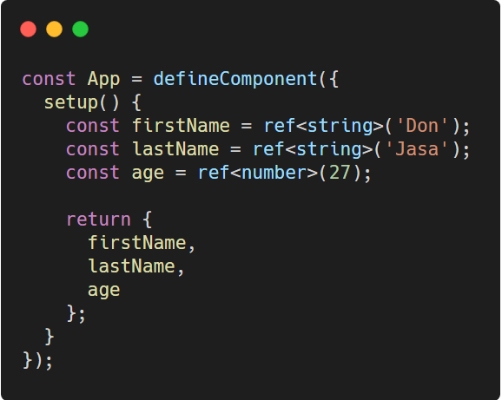
Replacing “data” with “refs”
Replacing Options API
ref creates a reference to a reactive value which we can use in the template
Notes:
In order for us to use such values, we need to expose them to the template by returning them as an object.
NOTE: ref creates an object, under the hood that object has a value. You need to such property if you need to modify your data property
TypeScript: https://carbon.now.sh/?bg=rgba%28255%2C255%2C255%2C1%29&t=vscode&wt=none&l=javascript&ds=false&dsyoff=20px&dsblur=68px&wc=true&wa=true&pv=56px&ph=56px&ln=false&fl=1&fm=Hack&fs=14px&lh=133%25&si=false&es=2x&wm=false&code=const%2520App%2520%253D%2520defineComponent%28%257B%250A%2520%2520setup%28%29%2520%257B%250A%2520%2520%2520%2520const%2520firstName%2520%253D%2520ref%253Cstring%253E%28%27Don%27%29%253B%250A%2520%2520%2520%2520const%2520lastName%2520%253D%2520ref%253Cstring%253E%28%27Jasa%27%29%253B%250A%2520%2520%2520%2520const%2520age%2520%253D%2520ref%253Cnumber%253E%2827%29%253B%250A%250A%2520%2520%2520%2520return%2520%257B%250A%2520%2520%2520%2520%2520%2520firstName%252C%250A%2520%2520%2520%2520%2520%2520lastName%252C%250A%2520%2520%2520%2520%2520%2520age%250A%2520%2520%2520%2520%257D%253B%250A%2520%2520%257D%250A%257D%29%253B

Slide 13
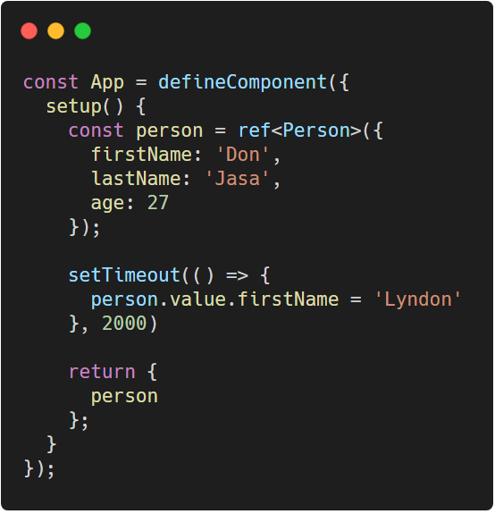
Reactivity
Replacing Options API
For data that can be grouped, chances are high that they are usually put inside an object
Notes:
This works without any problem BUT, this means we’d have to modify our template such that it is reading person.firstName and not plainly firstName
TypeScript: https://carbon.now.sh/?bg=rgba%28255%2C255%2C255%2C1%29&t=vscode&wt=none&l=javascript&ds=false&dsyoff=20px&dsblur=68px&wc=true&wa=true&pv=56px&ph=56px&ln=false&fl=1&fm=Hack&fs=14px&lh=133%25&si=false&es=2x&wm=false&code=const%2520App%2520%253D%2520defineComponent%28%257B%250A%2520%2520setup%28%29%2520%257B%250A%2520%2520%2520%2520const%2520person%2520%253D%2520ref%253CPerson%253E%28%257B%250A%2520%2520%2520%2520%2520%2520firstName%253A%2520%27Don%27%252C%250A%2520%2520%2520%2520%2520%2520lastName%253A%2520%27Jasa%27%252C%250A%2520%2520%2520%2520%2520%2520age%253A%252027%250A%2520%2520%2520%2520%257D%29%253B%250A%250A%2520%2520%2520%2520setTimeout%28%28%29%2520%253D%253E%2520%257B%250A%2520%2520%2520%2520%2520%2520person.value.firstName%2520%253D%2520%27Lyndon%27%250A%2520%2520%2520%2520%257D%252C%25202000%29%250A%250A%2520%2520%2520%2520return%2520%257B%250A%2520%2520%2520%2520%2520%2520person%250A%2520%2520%2520%2520%257D%253B%250A%2520%2520%257D%250A%257D%29%253B

Slide 14
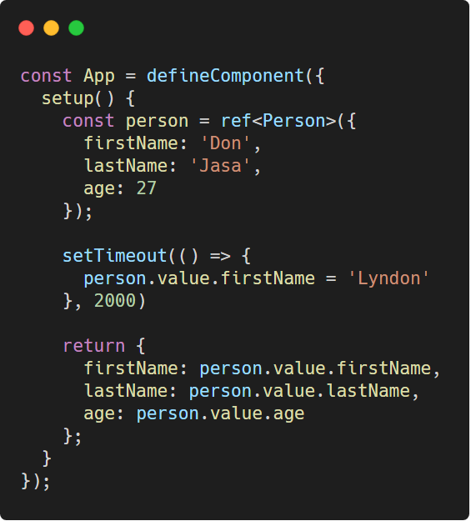
Reactivity
Replacing Options API
While the object put inside a ref is reactive, its properties are not
Notes:
In this code, after two seconds, the update of the name won’t be reflected on the template. The update fired on the code, Vue tracked it without problem. The problem is on what we are exposing. What we can expose instead is the whole person object.
TypeScript: https://carbon.now.sh/?bg=rgba%28255%2C255%2C255%2C1%29&t=vscode&wt=none&l=javascript&ds=false&dsyoff=20px&dsblur=68px&wc=true&wa=true&pv=56px&ph=56px&ln=false&fl=1&fm=Hack&fs=14px&lh=133%25&si=false&es=2x&wm=false&code=const%2520App%2520%253D%2520defineComponent%28%257B%250A%2520%2520setup%28%29%2520%257B%250A%2520%2520%2520%2520const%2520person%2520%253D%2520ref%253CPerson%253E%28%257B%250A%2520%2520%2520%2520%2520%2520firstName%253A%2520%27Don%27%252C%250A%2520%2520%2520%2520%2520%2520lastName%253A%2520%27Jasa%27%252C%250A%2520%2520%2520%2520%2520%2520age%253A%252027%250A%2520%2520%2520%2520%257D%29%253B%250A%250A%2520%2520%2520%2520setTimeout%28%28%29%2520%253D%253E%2520%257B%250A%2520%2520%2520%2520%2520%2520person.value.firstName%2520%253D%2520%27Lyndon%27%250A%2520%2520%2520%2520%257D%252C%25202000%29%250A%250A%2520%2520%2520%2520return%2520%257B%250A%2520%2520%2520%2520%2520%2520firstName%253A%2520person.value.firstName%252C%250A%2520%2520%2520%2520%2520%2520lastName%253A%2520person.value.lastName%252C%250A%2520%2520%2520%2520%2520%2520age%253A%2520person.value.age%250A%2520%2520%2520%2520%257D%253B%250A%2520%2520%257D%250A%257D%29%253B

Slide 15
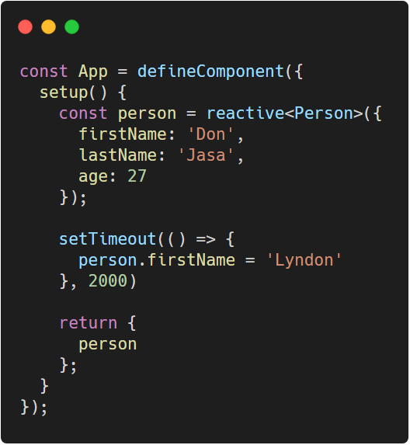
Reactivity
Replacing Options API
If you don’t want the value wrapping of ref, use reactive instead.
Reactive is explicitly for objects
Notes:
While ref works with any kind of type. Reactive only works with object.
It doesn’t wrap your object with a value, the whole object itself is wrapped inside a proxy.
As objects tend to become bigger, reactive is preferred for objects.
TypeScript: https://carbon.now.sh/?bg=rgba%28255%2C255%2C255%2C1%29&t=vscode&wt=none&l=javascript&ds=false&dsyoff=20px&dsblur=68px&wc=true&wa=true&pv=56px&ph=56px&ln=false&fl=1&fm=Hack&fs=14px&lh=133%25&si=false&es=2x&wm=false&code=const%2520App%2520%253D%2520defineComponent%28%257B%250A%2520%2520setup%28%29%2520%257B%250A%2520%2520%2520%2520const%2520person%2520%253D%2520reactive%253CPerson%253E%28%257B%250A%2520%2520%2520%2520%2520%2520firstName%253A%2520%27Don%27%252C%250A%2520%2520%2520%2520%2520%2520lastName%253A%2520%27Jasa%27%252C%250A%2520%2520%2520%2520%2520%2520age%253A%252027%250A%2520%2520%2520%2520%257D%29%253B%250A%250A%2520%2520%2520%2520setTimeout%28%28%29%2520%253D%253E%2520%257B%250A%2520%2520%2520%2520%2520%2520person.firstName%2520%253D%2520%27Lyndon%27%250A%2520%2520%2520%2520%257D%252C%25202000%29%250A%250A%2520%2520%2520%2520return%2520%257B%250A%2520%2520%2520%2520%2520%2520person%250A%2520%2520%2520%2520%257D%253B%250A%2520%2520%257D%250A%257D%29%253B

Slide 16
Reactivity
Replacing Options API
ref
reactive
Can be used for any types
Wraps your ref object with a value property
Explicit for objects
Does not wrap your object with a value property
Notes:
In both cases, only the entire object is reactive while the properties inside is not.

Slide 17
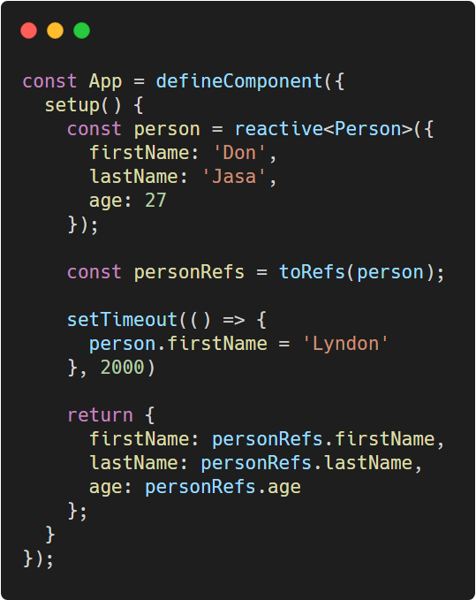
toRefs function
Replacing Options API
Optionally, you may turn all properties inside your object into refs just before exposure
Notes:
this is for use cases where you don’t want to expose the whole object. And still the changes are meant to be made on the object wrapped by toRefs
TypeScript: https://carbon.now.sh/?bg=rgba%28255%2C255%2C255%2C1%29&t=vscode&wt=none&l=javascript&ds=false&dsyoff=20px&dsblur=68px&wc=true&wa=true&pv=56px&ph=56px&ln=false&fl=1&fm=Hack&fs=14px&lh=133%25&si=false&es=2x&wm=false&code=const%2520App%2520%253D%2520defineComponent%28%257B%250A%2520%2520setup%28%29%2520%257B%250A%2520%2520%2520%2520const%2520person%2520%253D%2520reactive%253CPerson%253E%28%257B%250A%2520%2520%2520%2520%2520%2520firstName%253A%2520%27Don%27%252C%250A%2520%2520%2520%2520%2520%2520lastName%253A%2520%27Jasa%27%252C%250A%2520%2520%2520%2520%2520%2520age%253A%252027%250A%2520%2520%2520%2520%257D%29%253B%250A%250A%2520%2520%2520%2520const%2520personRefs%2520%253D%2520toRefs%28person%29%253B%250A%250A%2520%2520%2520%2520setTimeout%28%28%29%2520%253D%253E%2520%257B%250A%2520%2520%2520%2520%2520%2520person.firstName%2520%253D%2520%27Lyndon%27%250A%2520%2520%2520%2520%257D%252C%25202000%29%250A%250A%2520%2520%2520%2520return%2520%257B%250A%2520%2520%2520%2520%2520%2520firstName%253A%2520personRefs.firstName%252C%250A%2520%2520%2520%2520%2520%2520lastName%253A%2520personRefs.lastName%252C%250A%2520%2520%2520%2520%2520%2520age%253A%2520personRefs.age%250A%2520%2520%2520%2520%257D%253B%250A%2520%2520%257D%250A%257D%29%253B

Slide 18
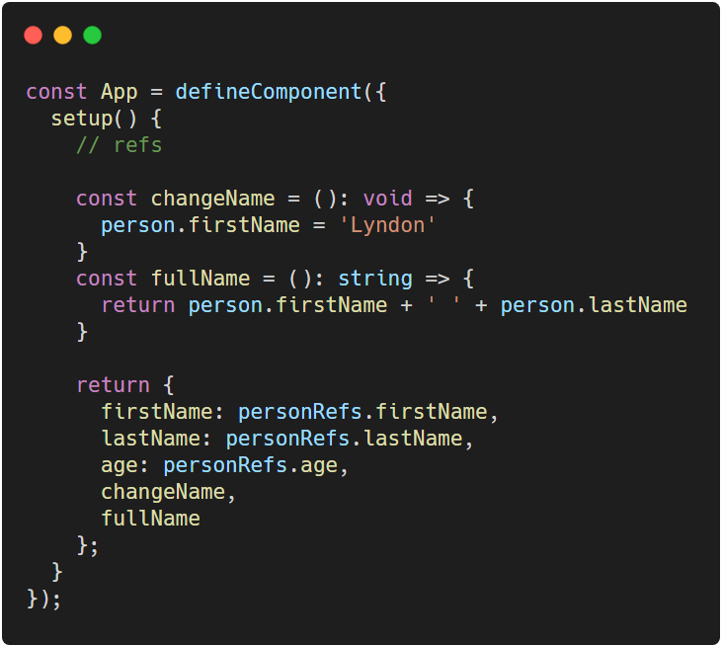
Replacing “methods” with regular functions
Replacing Options API
You can define functions inside your setup and expose them to the template as well
Notes:
TypeScript: https://carbon.now.sh/?bg=rgba%28255%2C255%2C255%2C1%29&t=vscode&wt=none&l=javascript&ds=false&dsyoff=20px&dsblur=68px&wc=true&wa=true&pv=56px&ph=56px&ln=false&fl=1&fm=Hack&fs=14px&lh=133%25&si=false&es=2x&wm=false&code=const%2520App%2520%253D%2520defineComponent%28%257B%250A%2520%2520setup%28%29%2520%257B%250A%2520%2520%2520%2520%252F%252F%2520refs%250A%250A%2520%2520%2520%2520const%2520changeName%2520%253D%2520%28%29%253A%2520void%2520%253D%253E%2520%257B%250A%2520%2520%2520%2520%2520%2520person.firstName%2520%253D%2520%27Lyndon%27%250A%2520%2520%2520%2520%257D%250A%2520%2520%2520%2520const%2520fullName%2520%253D%2520%28%29%253A%2520string%2520%253D%253E%2520%257B%250A%2520%2520%2520%2520%2520%2520return%2520person.firstName%2520%252B%2520%27%2520%27%2520%252B%2520person.lastName%250A%2520%2520%2520%2520%257D%250A%250A%2520%2520%2520%2520return%2520%257B%250A%2520%2520%2520%2520%2520%2520firstName%253A%2520personRefs.firstName%252C%250A%2520%2520%2520%2520%2520%2520lastName%253A%2520personRefs.lastName%252C%250A%2520%2520%2520%2520%2520%2520age%253A%2520personRefs.age%252C%250A%2520%2520%2520%2520%2520%2520changeName%252C%250A%2520%2520%2520%2520%2520%2520fullName%250A%2520%2520%2520%2520%257D%253B%250A%2520%2520%257D%250A%257D%29%253B

Slide 19
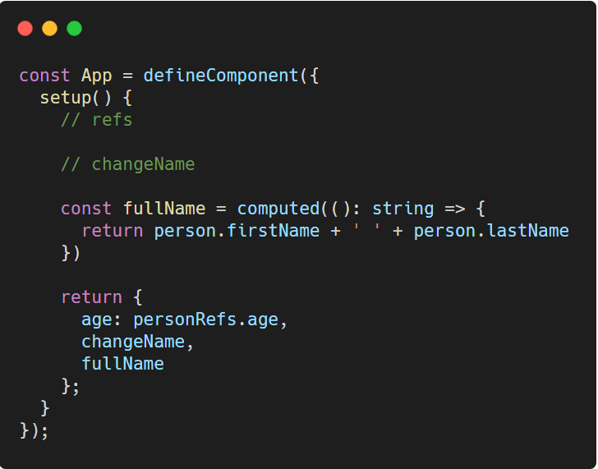
Replacing computed option
Replacing Options API
You can wrap a function with the computed function to turn it into a computed property
Notes:
Such function should have no arguments
TypeScript: https://carbon.now.sh/?bg=rgba%28255%2C255%2C255%2C1%29&t=vscode&wt=none&l=javascript&ds=false&dsyoff=20px&dsblur=68px&wc=true&wa=true&pv=56px&ph=56px&ln=false&fl=1&fm=Hack&fs=14px&lh=133%25&si=false&es=2x&wm=false&code=const%2520App%2520%253D%2520defineComponent%28%257B%250A%2520%2520setup%28%29%2520%257B%250A%2520%2520%2520%2520%252F%252F%2520refs%250A%250A%2520%2520%2520%2520%252F%252F%2520changeName%250A%250A%2520%2520%2520%2520const%2520fullName%2520%253D%2520computed%28%28%29%253A%2520string%2520%253D%253E%2520%257B%250A%2520%2520%2520%2520%2520%2520return%2520person.firstName%2520%252B%2520%27%2520%27%2520%252B%2520person.lastName%250A%2520%2520%2520%2520%257D%29%250A%250A%2520%2520%2520%2520return%2520%257B%250A%2520%2520%2520%2520%2520%2520age%253A%2520personRefs.age%252C%250A%2520%2520%2520%2520%2520%2520changeName%252C%250A%2520%2520%2520%2520%2520%2520fullName%250A%2520%2520%2520%2520%257D%253B%250A%2520%2520%257D%250A%257D%29%253B

Slide 20
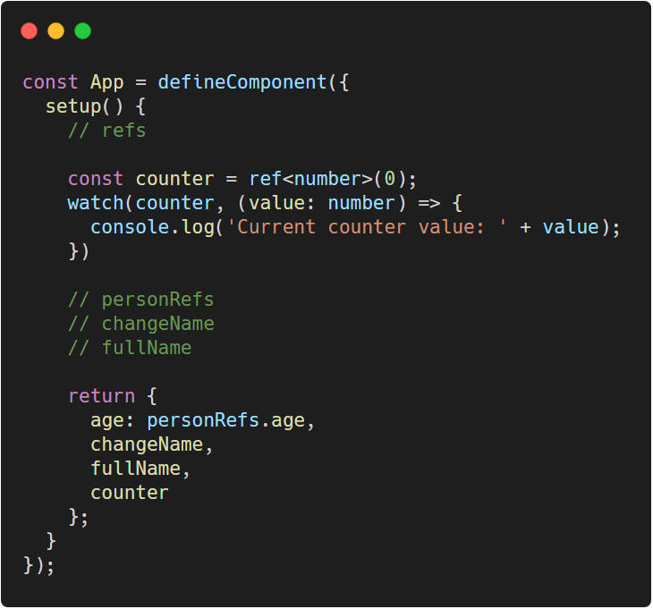
Working with watch
Replacing Options API
For watchers, you pass in the ref/reactive property and the function that runs after it updates
Notes:
instead of creating a function with the same name as the one you are dependent, you pass it inside the watch function.
Notice the placement of code. Suddenly you have the watch right after the counter ref we just created. This is what we mean that we can group relevant code with one another.
TypeScript: https://carbon.now.sh/?bg=rgba%28255%2C255%2C255%2C1%29&t=vscode&wt=none&l=javascript&ds=false&dsyoff=20px&dsblur=68px&wc=true&wa=true&pv=56px&ph=56px&ln=false&fl=1&fm=Hack&fs=14px&lh=133%25&si=false&es=2x&wm=false&code=const%2520App%2520%253D%2520defineComponent%28%257B%250A%2520%2520setup%28%29%2520%257B%250A%2520%2520%2520%2520%252F%252F%2520refs%250A%250A%2520%2520%2520%2520const%2520counter%2520%253D%2520ref%253Cnumber%253E%280%29%253B%250A%2520%2520%2520%2520watch%28counter%252C%2520%28value%253A%2520number%29%2520%253D%253E%2520%257B%250A%2520%2520%2520%2520%2520%2520console.log%28%27Current%2520counter%2520value%253A%2520%27%2520%252B%2520value%29%253B%250A%2520%2520%2520%2520%257D%29%250A%250A%2520%2520%2520%2520%252F%252F%2520personRefs%250A%2520%2520%2520%2520%252F%252F%2520changeName%250A%2520%2520%2520%2520%252F%252F%2520fullName%250A%250A%2520%2520%2520%2520return%2520%257B%250A%2520%2520%2520%2520%2520%2520age%253A%2520personRefs.age%252C%250A%2520%2520%2520%2520%2520%2520changeName%252C%250A%2520%2520%2520%2520%2520%2520fullName%252C%250A%2520%2520%2520%2520%2520%2520counter%250A%2520%2520%2520%2520%257D%253B%250A%2520%2520%257D%250A%257D%29%253B

Slide 21
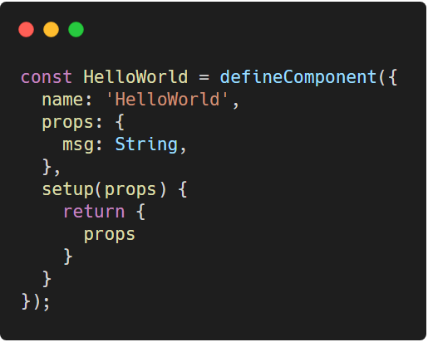
Passing in Props
Replacing Options API
The setup parameter receives a props object. This will contain all the props you have configured
Notes:
Note that we still have our HelloWorld.vue, we can make use of it for the props
In React, you can destructure the props, in Vue it is not recommended as you would lose the reactivity upon destructuring. Also, in order to have access on prop values on the template, return the whole props object.
TypeScript: https://carbon.now.sh/?bg=rgba%28255%2C255%2C255%2C1%29&t=vscode&wt=none&l=javascript&ds=false&dsyoff=20px&dsblur=68px&wc=true&wa=true&pv=56px&ph=56px&ln=false&fl=1&fm=Hack&fs=14px&lh=133%25&si=false&es=2x&wm=false&code=const%2520HelloWorld%2520%253D%2520defineComponent%28%257B%250A%2520%2520name%253A%2520%27HelloWorld%27%252C%250A%2520%2520props%253A%2520%257B%250A%2520%2520%2520%2520msg%253A%2520String%252C%250A%2520%2520%257D%252C%250A%2520%2520setup%28props%29%2520%257B%250A%2520%2520%2520%2520return%2520%257B%250A%2520%2520%2520%2520%2520%2520props%250A%2520%2520%2520%2520%257D%250A%2520%2520%257D%250A%257D%29%253B

Slide 22
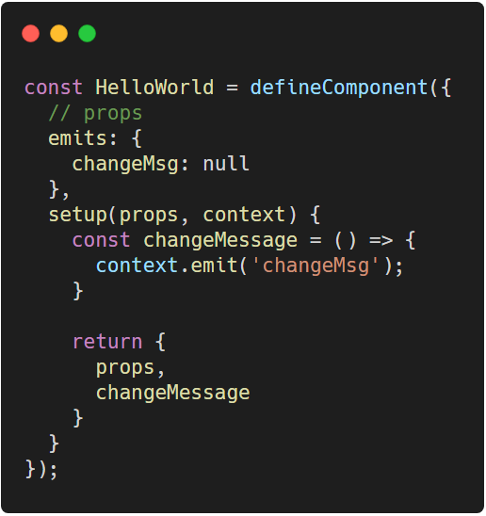
Emitting Events
Replacing Options API
A second parameter called context, is also received by the setup function. This contains an emit function
Notes:
Still, you need to define your emits on the emits option.
TypeScript: https://carbon.now.sh/?bg=rgba%28255%2C255%2C255%2C1%29&t=vscode&wt=none&l=javascript&ds=false&dsyoff=20px&dsblur=68px&wc=true&wa=true&pv=56px&ph=56px&ln=false&fl=1&fm=Hack&fs=14px&lh=133%25&si=false&es=2x&wm=false&code=const%2520HelloWorld%2520%253D%2520defineComponent%28%257B%250A%2520%2520%252F%252F%2520props%250A%2520%2520emits%253A%2520%257B%250A%2520%2520%2520%2520changeMsg%253A%2520null%250A%2520%2520%257D%252C%250A%2520%2520setup%28props%252C%2520context%29%2520%257B%250A%2520%2520%2520%2520const%2520changeMessage%2520%253D%2520%28%29%2520%253D%253E%2520%257B%2520%250A%2520%2520%2520%2520%2520%2520context.emit%28%27changeMsg%27%29%253B%2520%250A%2520%2520%2520%2520%257D%250A%250A%2520%2520%2520%2520return%2520%257B%250A%2520%2520%2520%2520%2520%2520props%252C%250A%2520%2520%2520%2520%2520%2520changeMessage%250A%2520%2520%2520%2520%257D%250A%2520%2520%257D%250A%257D%29%253B

Slide 23
Lifecycle Hooks
Replacing Options API
the setup method replaces the creation hooks. Everything that happens with beforeCreate and created runs on setup()

Slide 24
Lifecycle Hooks
Replacing Options API
For the other lifecycle hooks, all are prepended with prefix on and they receive a function. Such functions run when the lifecycle hook is due
beforeMount() is now onBeforeMounted()

Slide 25
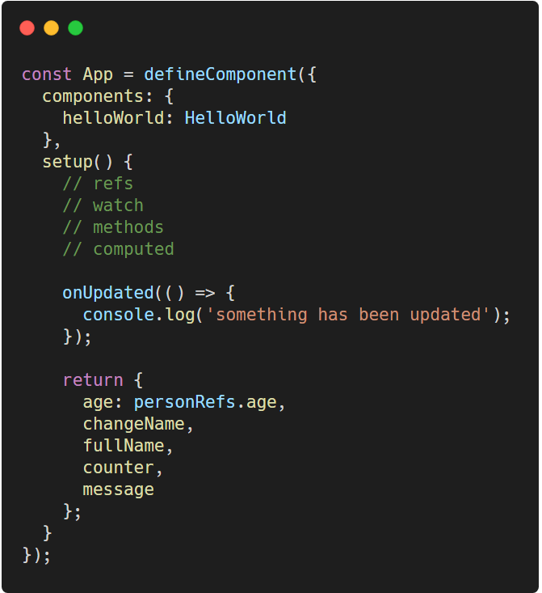
Lifecycle Hooks
Replacing Options API
As an example of updated lifecycle, in this code any changes on refs triggers a log.
Except for the watcher
Notes:
Why is that the watcher doesn’t trigger any logs?
TypeScript: https://carbon.now.sh/?bg=rgba%28255%2C255%2C255%2C1%29&t=vscode&wt=none&l=javascript&ds=false&dsyoff=20px&dsblur=68px&wc=true&wa=true&pv=56px&ph=56px&ln=false&fl=1&fm=Hack&fs=14px&lh=133%25&si=false&es=2x&wm=false&code=const%2520App%2520%253D%2520defineComponent%28%257B%250A%2520%2520components%253A%2520%257B%250A%2520%2520%2520%2520helloWorld%253A%2520HelloWorld%250A%2520%2520%257D%252C%250A%2520%2520setup%28%29%2520%257B%250A%2520%2520%2520%2520%252F%252F%2520refs%250A%2520%2520%2520%2520%252F%252F%2520watch%250A%2520%2520%2520%2520%252F%252F%2520methods%250A%2520%2520%2520%2520%252F%252F%2520computed%250A%250A%2520%2520%2520%2520onUpdated%28%28%29%2520%253D%253E%2520%257B%250A%2520%2520%2520%2520%2520%2520console.log%28%27something%2520has%2520been%2520updated%27%29%253B%250A%2520%2520%2520%2520%257D%29%253B%250A%250A%2520%2520%2520%2520return%2520%257B%250A%2520%2520%2520%2520%2520%2520age%253A%2520personRefs.age%252C%250A%2520%2520%2520%2520%2520%2520changeName%252C%250A%2520%2520%2520%2520%2520%2520fullName%252C%250A%2520%2520%2520%2520%2520%2520counter%252C%250A%2520%2520%2520%2520%2520%2520message%250A%2520%2520%2520%2520%257D%253B%250A%2520%2520%257D%250A%257D%29%253B

Slide 26
Thank You
Up Next . . . Reusability Concept
Notes:
Assignment, convert components in the Minute Burger Machine lecture code to composition API, except for those that have provide/inject and mixins

